Slide 1
Big Oh or big oh or big O notation
Big oh notation is used to provide an asymptotic upper bound for the performance of an algorithm
  We typically think of of runtime performance, but memory performance is also something that we can measure and are interested in
  We are typically interested in the performance as the size of the input increases in size (or moves towards infinity)
  We will stick with discussing runtime performance
Definition
  f(n) = O(g(n)), if there exist positive constants c and N₀, such that f(n) ≤ c ∙ g(n) for all n ≥ N₀
That is, the performance of f(n) is bounded above by O(g(n))

Slide 2
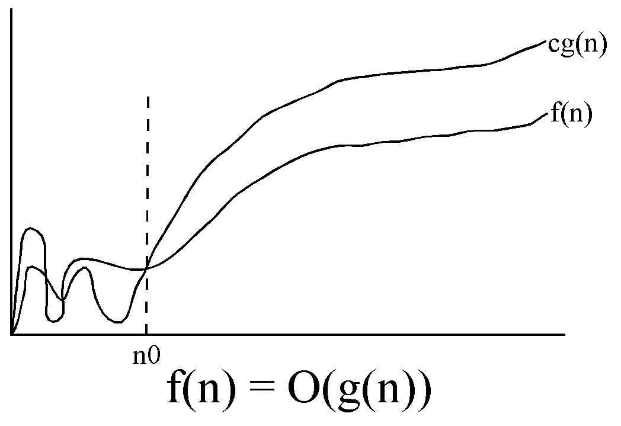
Definition
  f(n) = O(g(n)), if there exist positive constants c and N₀, such that f(n) ≤ c ∙ g(n) for all n ≥ N₀

Slide 3
You will learn much more about big oh when you take algorithms
Smaller values are better than larger values
  That is, O(1) < O(n) < O(n log n) < O(n²) … < O(n!) < …
Individual instructions typically take constant time, so O(1)
  These are simple instructions versus method calls
  If there was a builtin function for matrix multiplication, then that would not take constant time (anyone taking linear algebra?)
Non-nested loops typically take linear time based on the upper and lower bounds of the loop, so if the loop goes from 0 to n-1, we have O(n)
Two non-nested loops, both going from 0 to n-1, would be O(n), since we can get rid of the constant multiplier from our initial estimate of O(2n) (remember, f(n) ≤ c ∙ g(n), c is a constant)
Nested loops are multiplicative, such as the nested loops we had in our implementations of selection sort take O(n²)

Slide 4
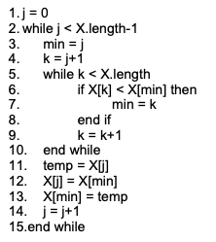
Let's look at selection sort for a moment, below is pseudo code for it

Slide 5
Selection sort analysis
Line 1 is executed once
The loop from 2 – 15 is executed n-1 times
n-1 times, since whatever is left after n-1 times is the maximum element and stays where it currently is
The loop from 5 – 10 is executed (n-1) + (n-2) + ... + 1 = (n*(n-1))/2 = (n²-n)/2.
The statement at line 7 is only executed some of the time, at most the same as loop from 5 – 10
Lines 11 – 14 are executed n-1 times
Although the amount of time this algorithm takes to execute on two arrays of size n may not be identical, the times will be similar. The difference between two runs of size n is how often line 7 executes. As we increase n, the length of time should increase. This is what we want to determine – how the algorithms run time changes as the input size increases.

Slide 6
Selection sort analysis (cont)
  The time that the algorithm runs should be the sum of the time it takes for each statement to run multiplied by the number of times the statement executes.
  Time for line 1 once
  Time for lines 2, 3, 4, 11, 12, 13, 14, 15 n-1 times
  Time for lines 5, 6, 8, 9, 10 (n²-n)/2 times
  Time for line 7 at most (n²-n)/2 times
We want to initially say the upper bound on performance is around 1 + 8(n-1) + 5(n²-n)/2 + 1(n²-n)/2

Slide 7
Selection sort analysis (cont)
We can get rid of the constant, since eventually there is an n large enough that the other lines take longer to execute
  Let's assume that line 1 takes one hour to execute. Each other line takes 1 second to execute. We can also assume that we are looking at the worst case. That is, every statement executes the maximum number of times. So, we have (8*(n-1)) + (5*((n*(n-1))/2)) + (1*((n*(n-1))/2)). For n=34, the time to do the other lines is slightly greater than 1 hour.
  Now, lets assume that the time to execute the other lines is closer to 1 thousandth of a second. For n=1,100 the time to do the other lines is slightly greater than 1 hour.
  Now, lets assume that the time to execute the other lines is closer to 1 millionth of a second. For n=35,000 the time to do the other lines is slightly greater than 1 hour.
  And finally, lets assume that the other lines take 1 billionth of a second to execute. For n=1,100,000 the time to do the other lines is slightly greater than 1 hour.

Slide 8
Selection sort analysis (cont)
  In the first case, we improve the performance of our computer by 1,000 times, yet an input of size less than 33 times the size of our previous input takes as much time to run. This improvement is similar when we increase the computer performance by 1,000 times two more times.
  We note that 33 is close to the square root of 1,000, so we see that the n² is dominating the time.
  So, as we can see. Substantial increases in computer performance does not necessarily yield linear performance in problem size increases (i.e., we need to develop efficient algorithms).
  We can also get rid of the n, since n² is larger and will eventually dominate the run time, no matter how long the instructions take to run that are executed n times

Slide 9
Selection sort analysis (cont)
  Now, (n²-n)/2 > n-1 for n >= 3. Thus for n >= 3, the number of times that lines 5, 6, 8, 9, 10 are executed is greater that any of the other lines. Thus, at some point there will be an n such that lines 5, 6, 8, 9, 10 take longer than any of the other lines (no matter how long any other individual line takes).
  As n gets large, (n²-n)/2 is very close to n². Thus this algorithm performance is related to n², where n is the number of elements in the array to sort.
When you take algorithms, you will evaluate the performance of many algorithms and use other techniques to do the analysis
  Such as when recursive functions are used
  And multiple calls to process subsets of the input
    Divide and conquer algorithms divide the input into smaller problems, and then solve the smaller problems, merging the results into a solution for the original problem
    Quicksort uses this approach

Slide 10
One last thing to keep in mind, if we limit n to be less than a fixed value, then the runtime performance can be thought of as constant, O(1), since there is always a “c” and “n₀“ in which cg(n) is larger than f(n)
  Since once n is larger than the upper limit for the size of the input, f(n) stops growing
As a simple example, let's say we are going to sort a sample of data, but we are guaranteed that the sample will always be at most 50, whichever sorting algorithm we choose, there is a maximum time for any sample of size at most 50, so the sorting time is constant

